Slide 1
RETAIL ANALYTICS
Lauren Bendixen, Hyun Kim, Tim Yu

Slide 2
Introduction & Objectives

Slide 3
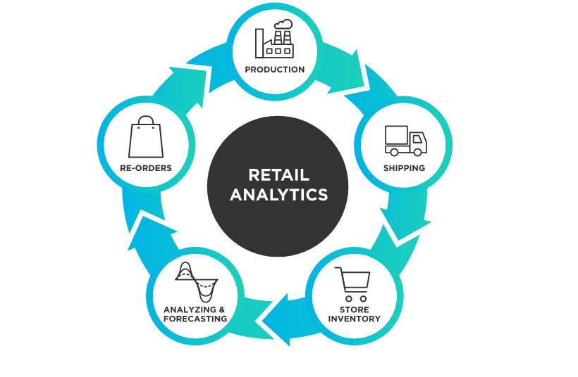
Retail Analytics
Process of discovering business insights by analyzing the performance of a business in terms of consumer demand and sales
These insights are used by the business to make crucial decisions and formulate management strategies in understanding customer behavior and subsequently generating profits
Demand forecasting is a key part of retail analytics, which is used to help the business to accurately predict and forecast sales based on customer data

Slide 4

Objectives
Conduct comprehensive analysis on Walmart sales through visualizations
Identify and analyze sales and determinants of the best and worst performing store
Perform regression using machine learning to forecast and predict weekly sales of Walmart:
OLS Linear Regression
Random Forest
Evaluate the regression models and conclude the best model

Slide 5
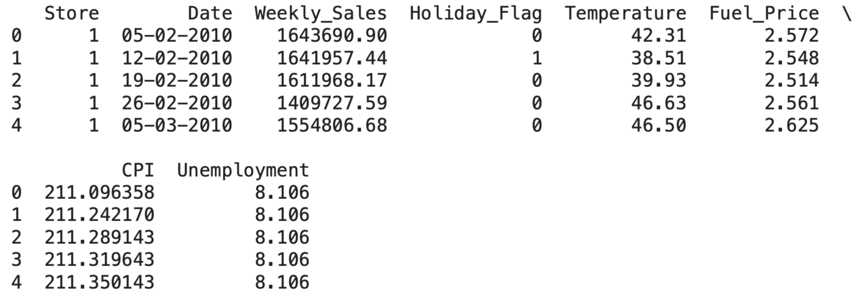
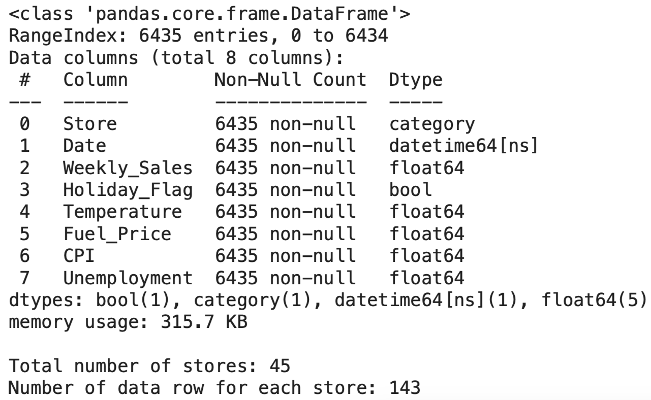
Walmart Dataset Overview
Variables:
Dependent: Weekly Sales
Independent:
Holiday Flag (Boolean)
Temperature
Fuel Price
CPI
Unemployment
Date will be included in visualization, but dropped in performing regression
Dataset Information:
6435 rows of data
45 stores
143 data rows for each store

Slide 6
Sales Performance

Slide 7
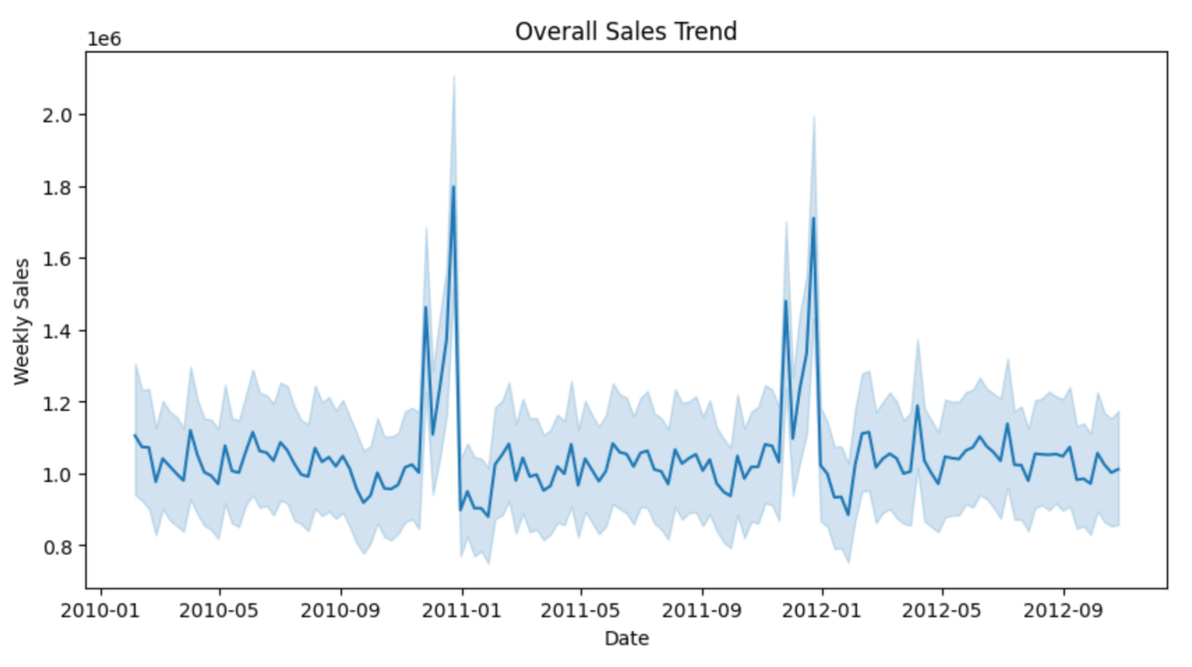
Sales Trend I: Overall Sales Trend
Sales start to increase from October until December
December has the highest sales
Comparatively stable, but low sales on the other months

Slide 8
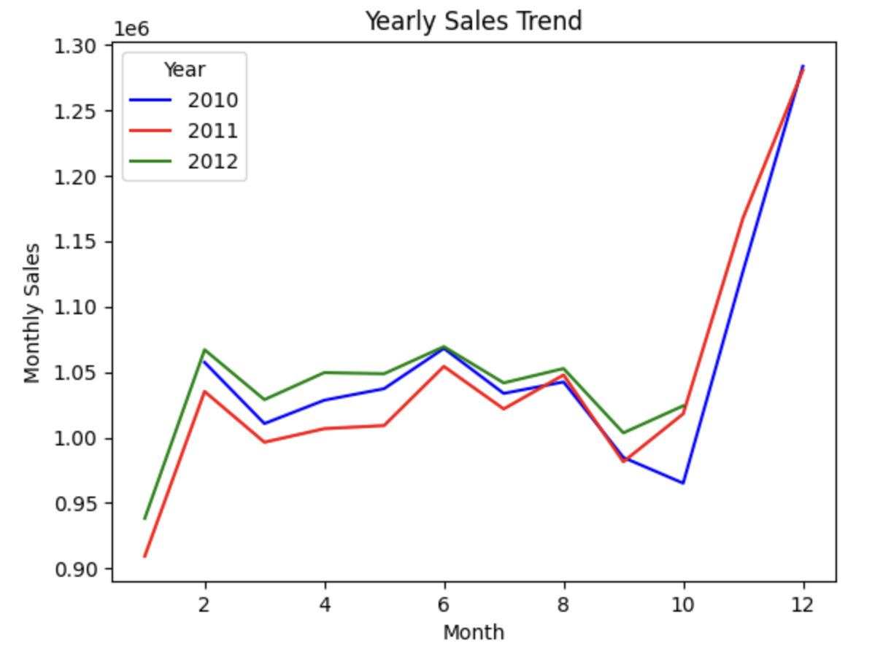
Sales Trend II: Yearly Sales Trend
Starting from October, sales increase: Fall Recess, Halloween and Thanksgiving
Highest sales recorded in December: Christmas Holiday
Starting from January, sales plummet: Holiday season ends and back to work

Slide 9
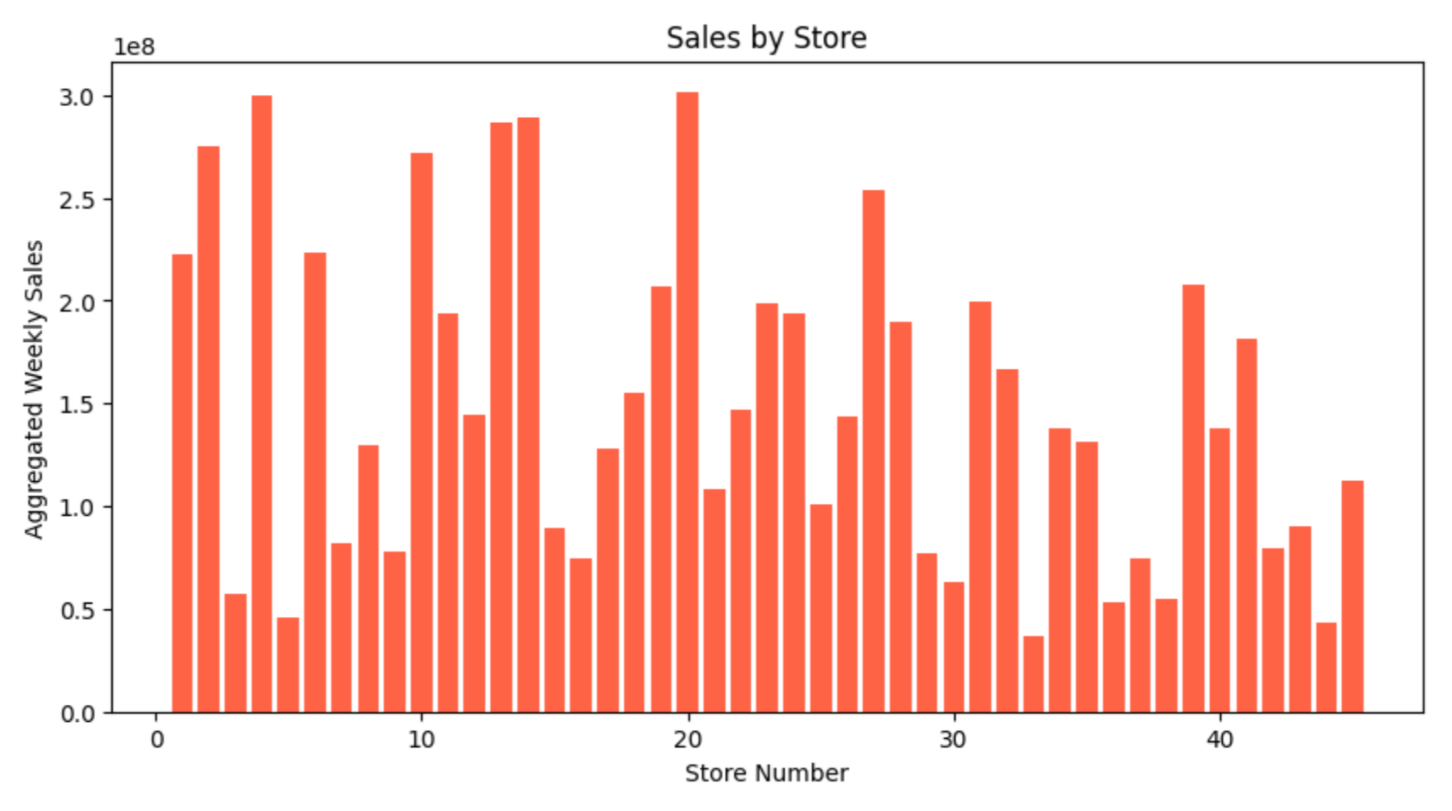
Sales Trend III: Sales by Store
Best Store: 20
Worst Store: 33

Slide 10
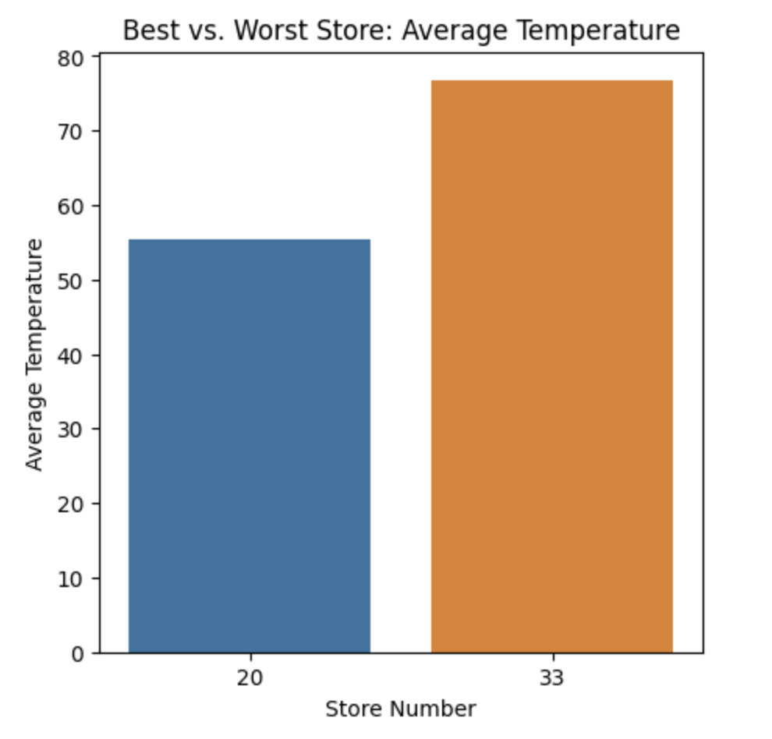
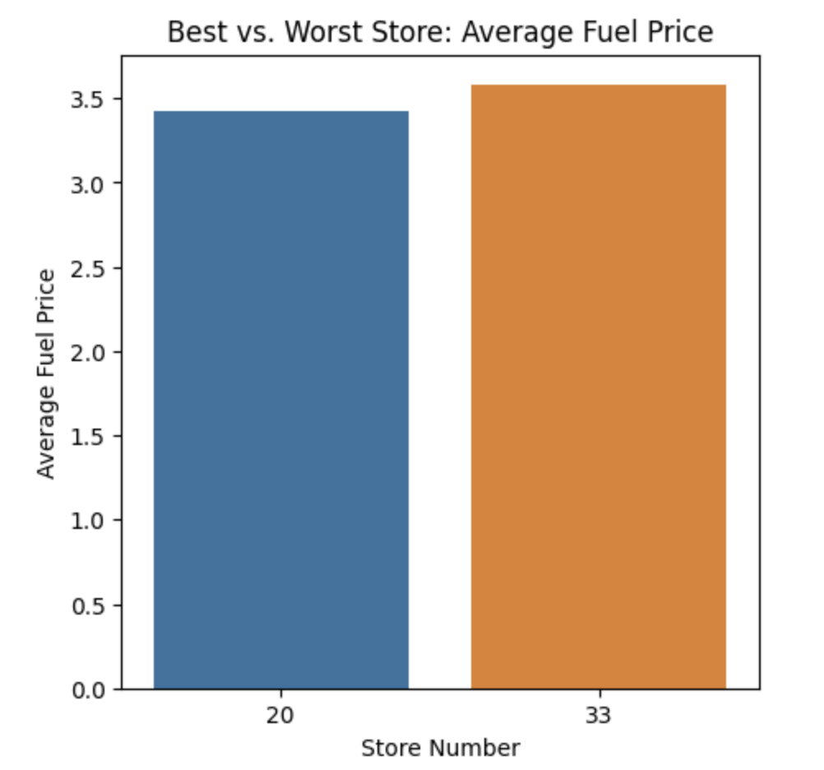
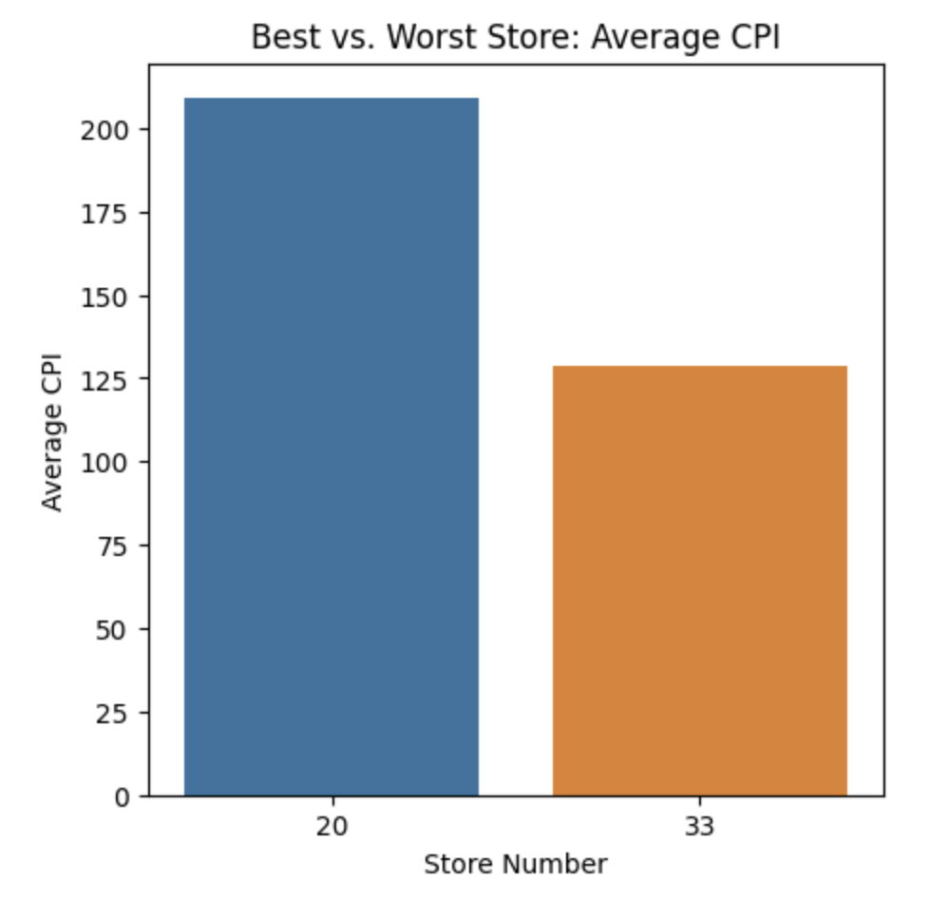
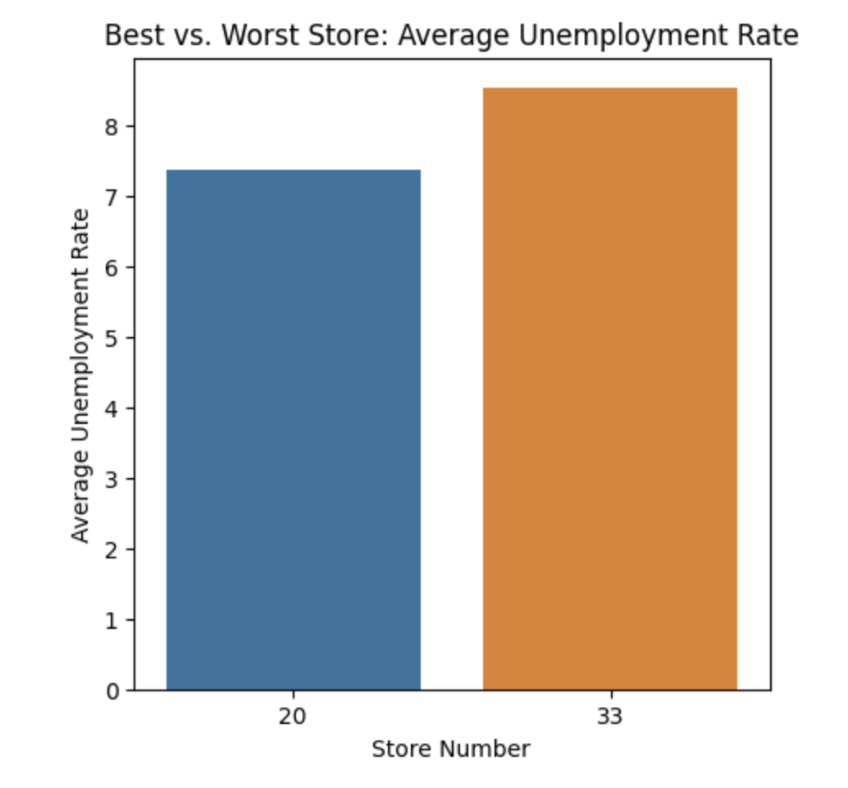
Best vs. Worst Store Analysis I: Comparison of Independent Variables
Best Store:
Lower Temperature,
Lower Fuel Price,
Lower Unemployment,
Higher CPI
Better environmental and economic factors indicate better sales performance

Slide 11
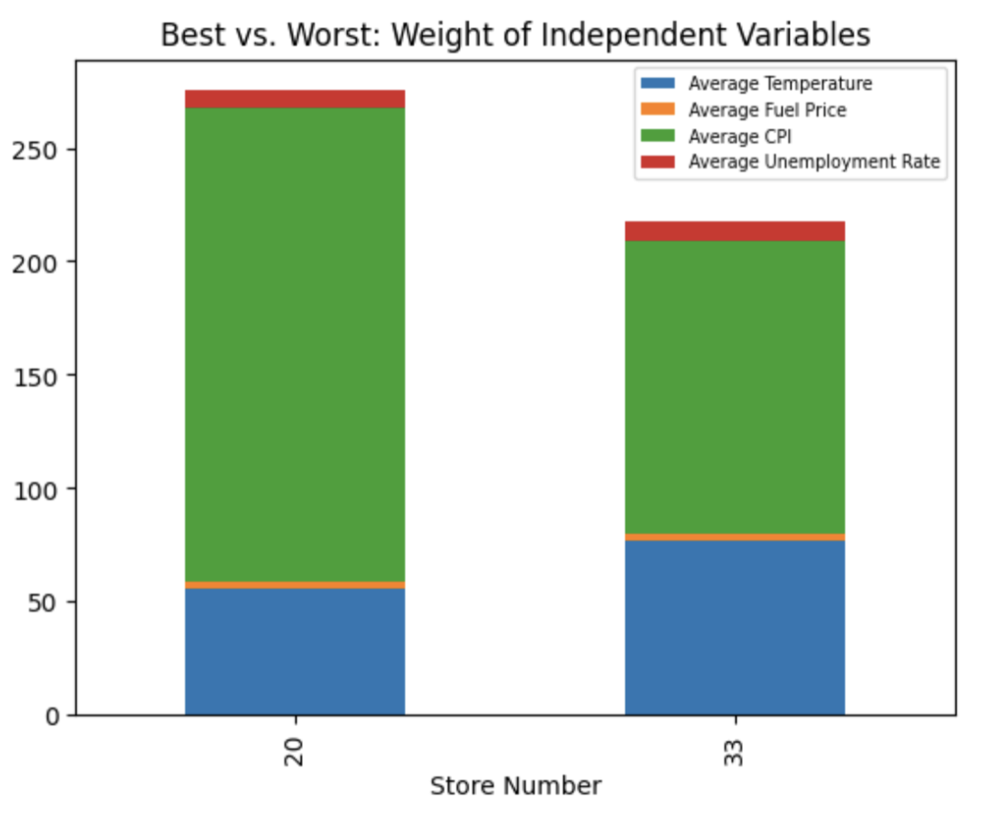
Best vs. Worst Store Analysis II: Weight of Independent Variables
Bar Plot Analysis: Significant numeric difference in independent variables
Normalization through data scaling could improve the dataset
OLS Linear Regression on normalized and unnormalized datasets will be compared to determine if normalization improves the linear regression model

Slide 12
Data Analysis & Cleaning

Slide 13
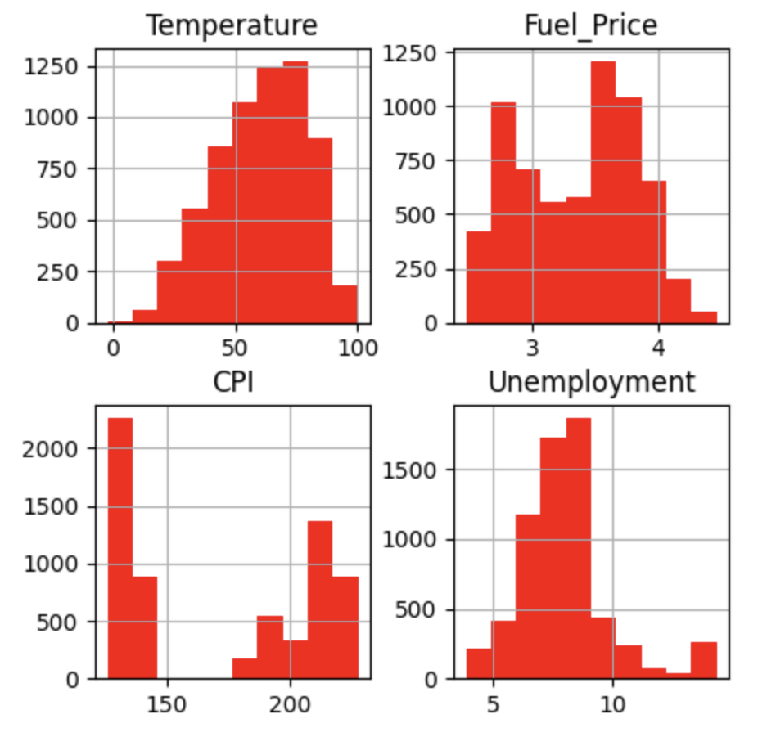
Probability Distribution
Normal Distribution:
Temperature & Unemployment Rate
Bimodal Distribution:
Fuel Price: Fluctuation of oil prices
Two Clusters:
CPI: Disparity in wealth and economic background of consumers
Box-Cox transformation could improve the dataset

Slide 14
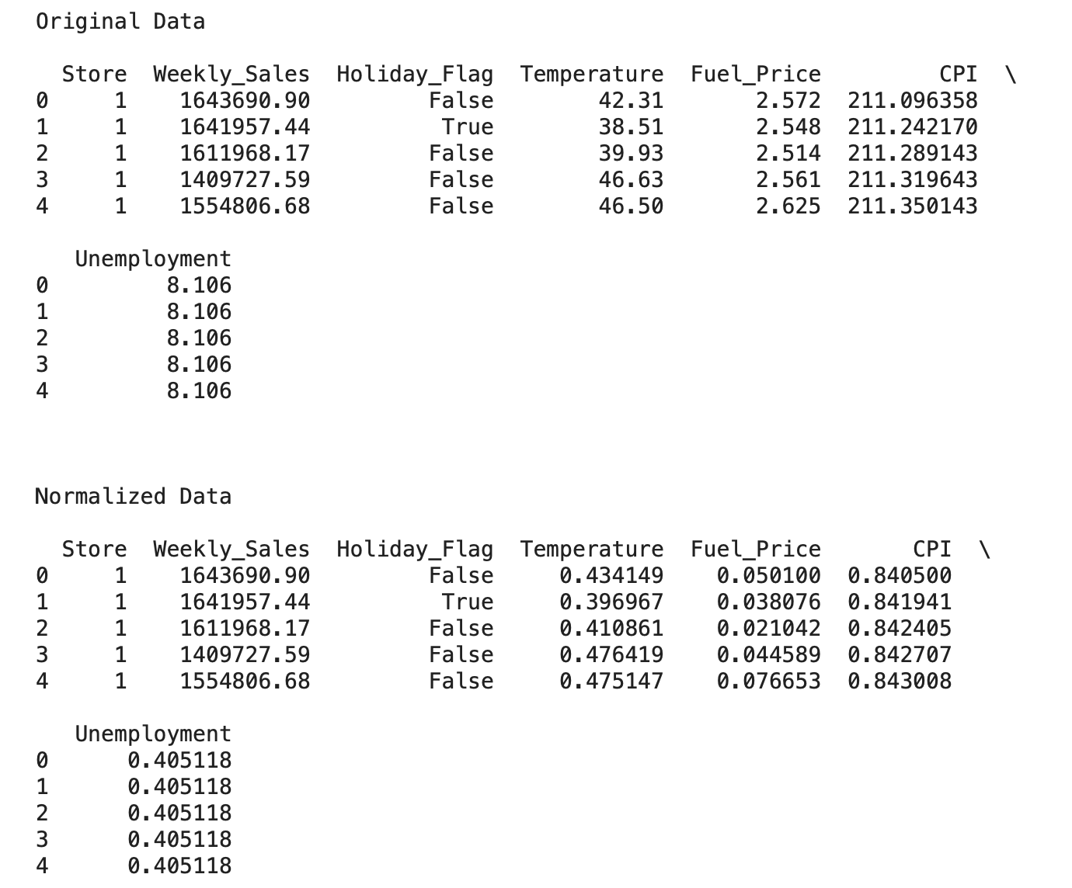
Normalization & Box-Cox Transformation
Normalization importing MinMaxScaler from sklearn module
Box-Cox Transformation importing boxcox from stats module
Box-Cox transforms a probability distribution into a normal distribution, potentially improving the data

Slide 15
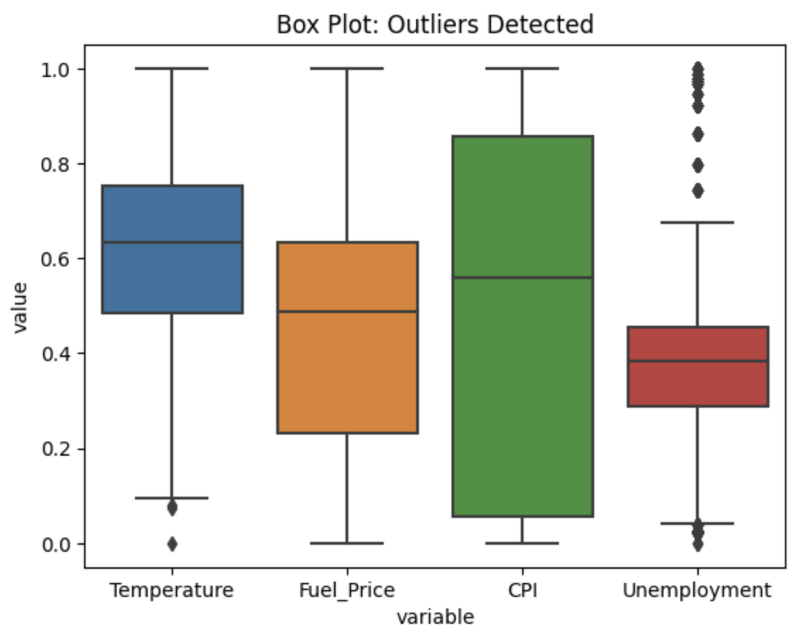
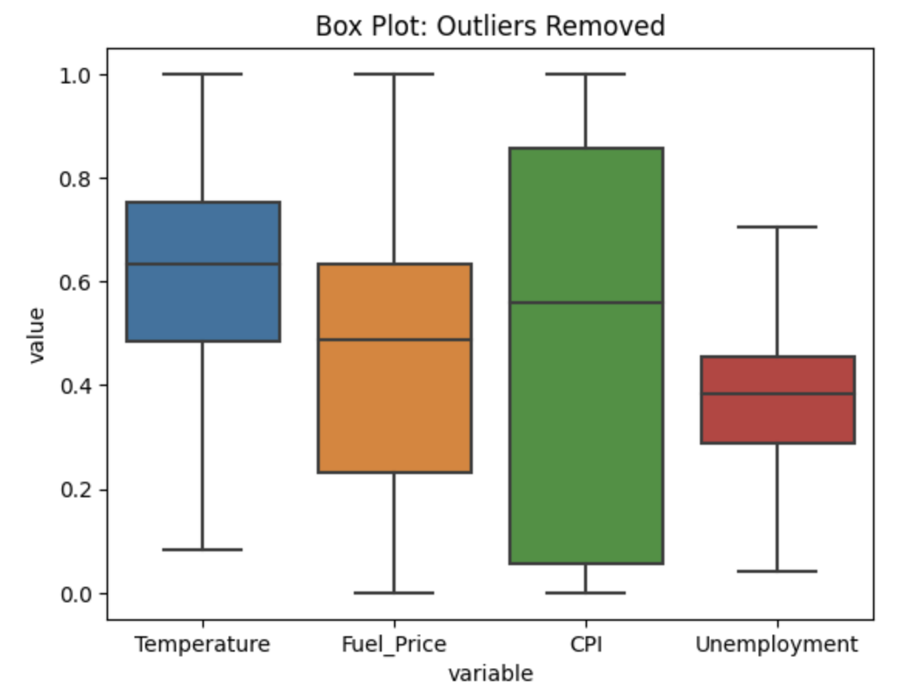
Outliers: IQR (Interquartile Range = 75th - 25th Percentile)
Outliers Detected in Normalized Data: Temperature & Unemployment Rate
Outliers Removed Through IQR Calculation: Data ± 1.5 * IQR

Slide 16
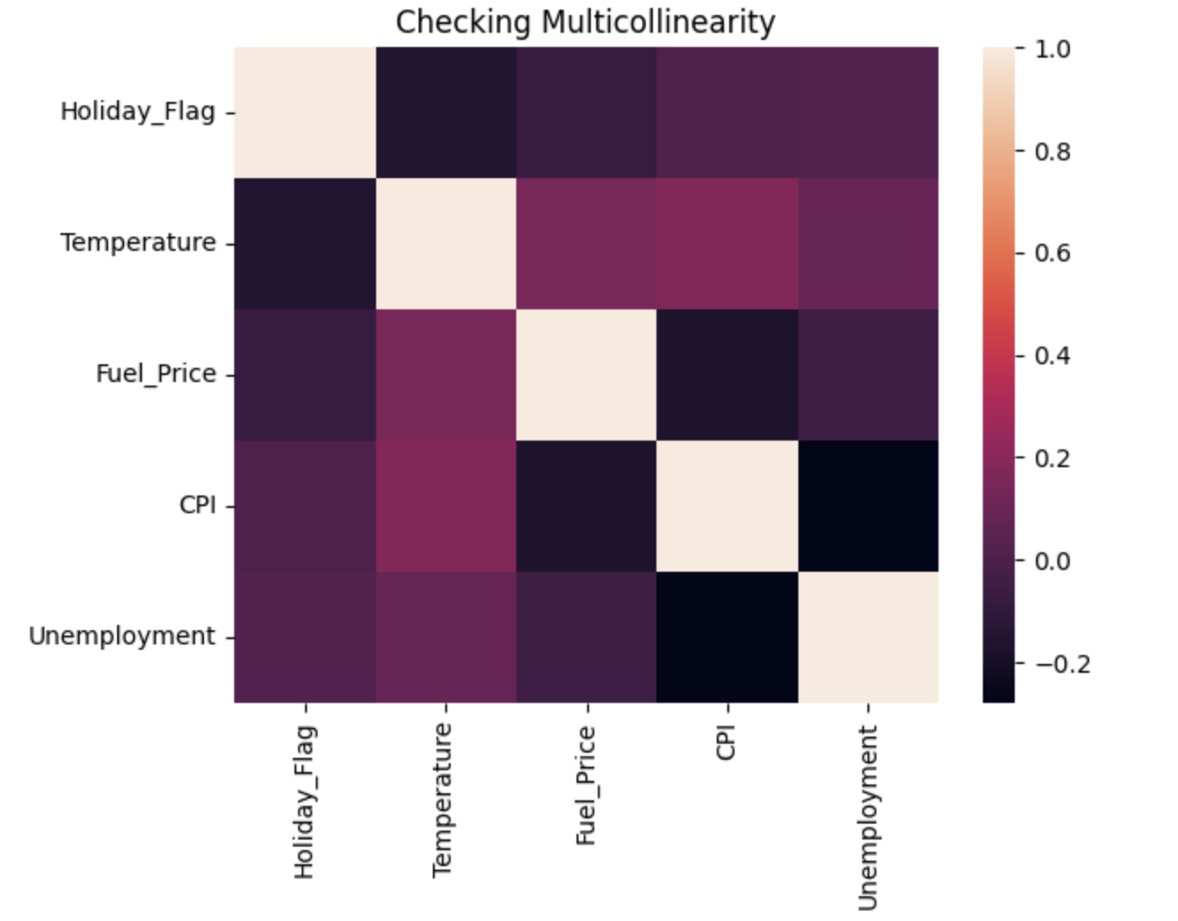
Multicollinearity: Heatmap Representation
The heatmap plots all the relationship between variables to show multicollinearity through a color index
All relationships in the heatmap have an index that does not exceed 0.4
Thus, there are no multicollinearity among the independent variables

Slide 17
Important Comments
Normalization, Box-Cox transformation and removing outliers do not always result in a more accurate regression model
Therefore, OLS linear regression will be performed on both the original dataset and the statistically cleaned dataset
Comparisons between the two datasets will be shown to convey which dataset results in a more accurate model for OLS linear regression
Random Forest will be performed only on the original dataset since its algorithm partitions the data and hence does not require data scaling or transformation
RMSE and Adjusted R^2 will be analyzed to determine the best model between the OLS Linear Regression and Random Forest models
Before we continue…

Slide 18
Regression Models for Demand Forecasting

Slide 19
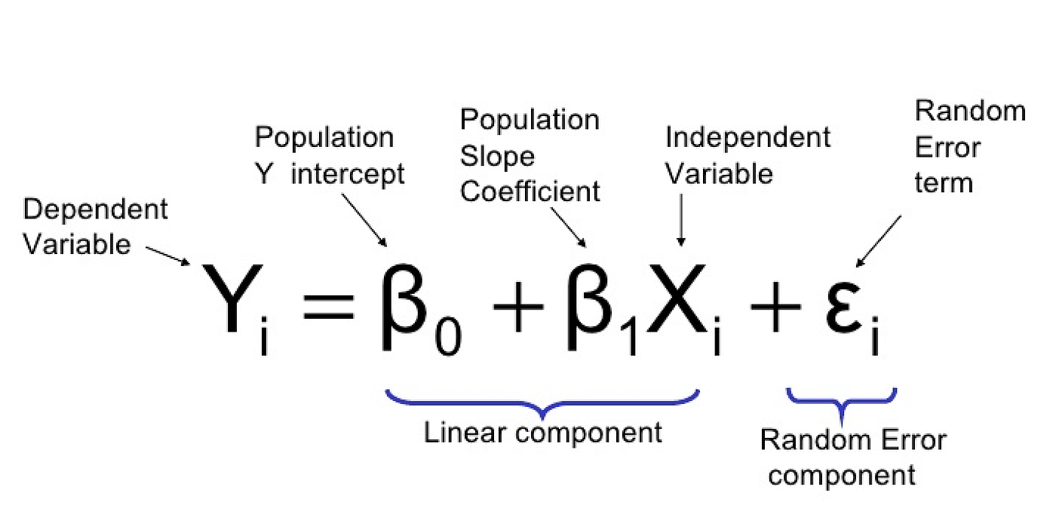
OLS Regression Model
Step 1
Divide dataset into training and testing dataset
Step 2
Fit training dataset into OLS model
Step 3
Predict the data with testing dataset
Step 4
Improve the regression model

Slide 20
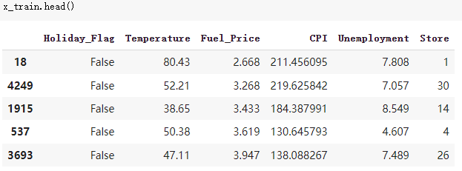
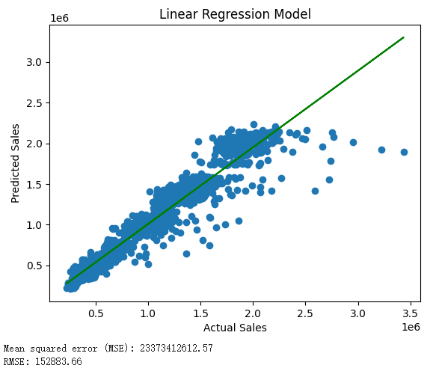
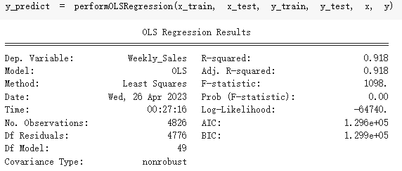
OLS Regression Model - Original Data

Slide 21
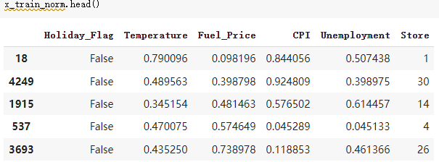

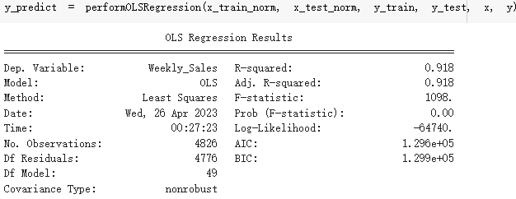
OLS Regression Model - Normalized Data

Slide 22
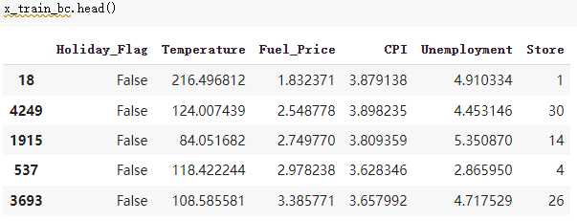
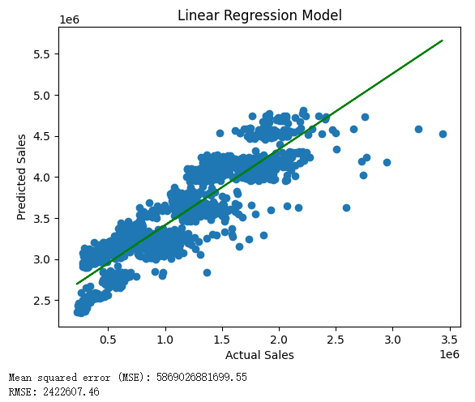
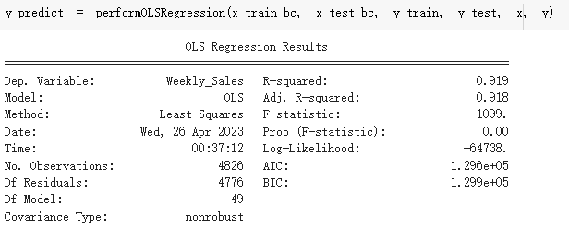
OLS Regression Model - Box-Cox Data

Slide 23
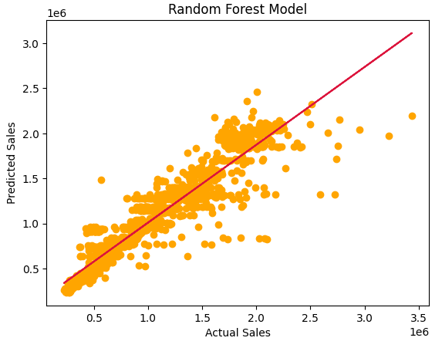
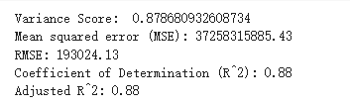
Random Forest Regression Model
Original data
Split the data into training data and testing data
x_train, x_test, y_train, y_test

Slide 24
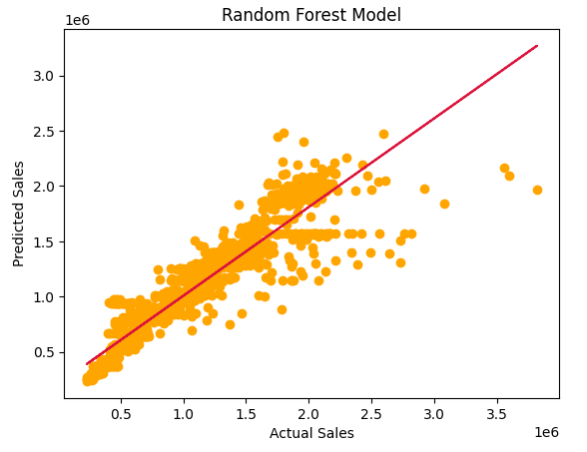
Comparison & Conclusion
OLS regression model with original dataset
RMSE: 152,883.66
Adjusted R^2: 0.918
Random Forest regression model
RMSE: 193,024.13
Adjusted R^2: 0.88

Slide 25
Thank you!
Any questions?

